Slide 11
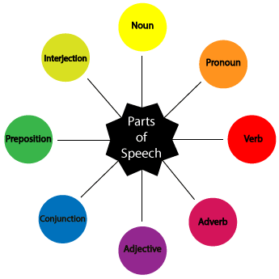
Articles
Demonstratives

Slide 12
Something staying the same
Something happening

Slide 13
Finite and non-finite verbs
Finite verb forms show tense, person and number (I go, she goes, we went, etc.):
-She was waiting in the room before he came in.
-Does your brother know my brother?
-The night before he had to leave, they sat on the small sofa in the living-room and looked at old family photos.
-Aren’t you a bit late?

Slide 14
Non-finite verb forms do not show tense, person or number. Typically they are infinitive forms with and without to (e.g. to go, go), -ing forms and -ed forms (e.g. going, gone) :
-She tiptoed round the house so as not to wake anyone.
-You need to paint the whole cupboard, starting from the bottom.

Slide 18
My best friend

Slide 19
To be complemented

